Slide 1


CSE240 Introduction to Programming Languages Day One Itinerary
Dr. Yinong Chen

Slide 2
Day One Itinerary
About the instructor
Courses taught
Other academic work
Contact
Syllabus discussion
Course outcomes
Graded activities and weights
Symbol grades with plus and minus
Classroom expectations

Slide 3
Instructor: Yinong Chen
Joined ASU CSE in 2001
This Semester:
CSE 240 (one section with 229 students)
CSE 445 / CSE598 / CSE598 Online with 129 students)
CSE 485 (two Sections with 48+ 31students)
Before this semester at ASU
CSE 101/FSE100: Every semester from Fall 06 to Fall 11
CSE230 F11, F12, S13, F13, F14
CSE 240: F01, S02, F02, S03, F03, S03, SS04, F04, S05, F05, S06, S07, S12, S13, F13, F14, S15
CSE 310: SS01, F01, SS02
CSE 225/EEE225: F02, S03, F03, S04, CSE 330: S2002, SS 2003 CSE 420/598: S01
CSE 423 (Capstone) S08, F09
CSE 445/598: Almost every semester since 2006 CSE 446/598 (Software Integration & Eng): SS10, SS11, Sp11, SS12, SS13, Sp14, SS14, Sp15

Slide 4
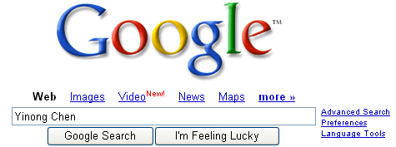
Yinong Chen
Before joining ASU
Taught for six years Department of Computer Science Wits University of Johannesburg, South Africa
Postdoc at LAAS-CNRS, Toulouse, France
Ph.D. from University of Karlsruhe (KIT), Germany
Contact and more … http://www.public.asu.edu/~ychen10/
Heinrich Hertz worked at KIT from 1885 to 1888, where he discovered electromagnetic waves

Slide 5
Yinong Chen
More than 10 books
200 research papers, 100 of which are after 2005 in service-oriented computing
Editor of international journals
Chair of international conferences
Keynote, panel talks
Teach high school students to program robots

Slide 6


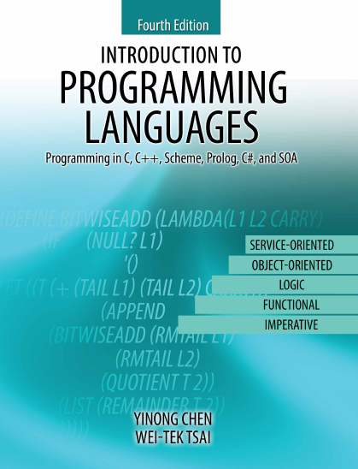
CSE240 Textbook
Y. Chen & W.T. Tsai, Introduction to Programming Language, Kendall Hunt Publishing, 4th Edition or 3rd Edition, 2012, 2014, or 2015,
Order: ASU bookstore or online at
http://www.kendallhunt.com/Search.aspx?searchTerm=Yinong%20Chen
Paper book
eBook
2012
2014
2015

Slide 7
Past Textbooks Used
The texts used before were:
Programming Languages Essentials by H. Bal and D. Grune, Addison-Wesley, 1993.
PC SCHEME MINIMANUAL AND
PROLOG MINIMANUAL, McGraw Hill, 1991.

Slide 8
Class Formats
Lecture
in classroom
Concepts, Principles, Methods, Theories
Lab tutorials
Exams
Online quiz
Quick test of what you have learned in the class.
Once a week, due by the end of each week.
Detailed schedule see Calendar file.
Homework / Project
Read the lecture slides before class
Read the slides, related book chapter/sections after the class
Complete the homework assignments
Exams
Mid-Term Exam tests the course materials covered in the first half, and the Final Exam tests the course materials covered in the second half.

Slide 9
Weight and Grading Scale
Percentage | Symbol Grade
96-100% 93-95% 90-92% | A+ A A-
86-89% 83-85% 80-82% | B+ B B-
76-79% 70-75% | C+ C
60-69% | D
Below 60% | E
Graded Activity | Weight
HW Assignments | 40%
Quizzes* | 20%
Mid-Term Exam | 18%
Final Exam | 22%
* The lowest two quiz scores will be dropped.
* No re-take or reset for any reason.

Slide 10
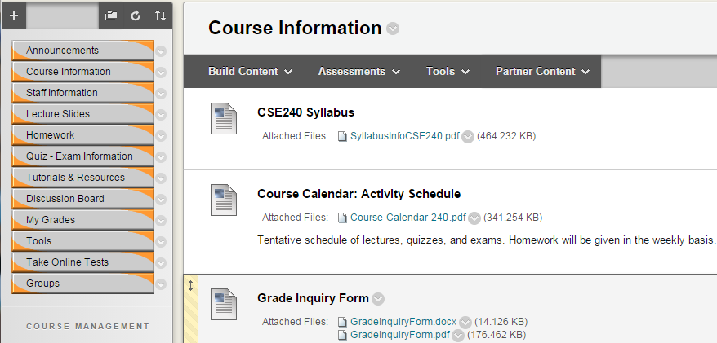
Course Blackboard Portal

Slide 11
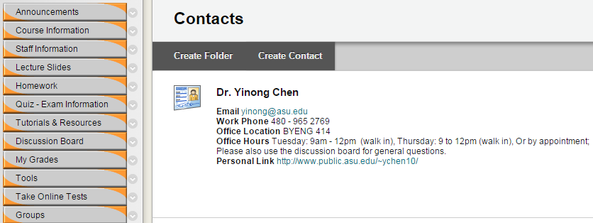
Course Blackboard Portal

Slide 12
CSE240 Objectives and Outcomes
Understand features of different programming paradigms
learn strong vs. weak typing in computer programming languages
learn control structures of functional, logic, and imperative programming languages.
learn the execution of functional, logic, and imperative programming languages.
learn the recursion mechanism of functional, logic, and imperative programming languages

Slide 13
CSE240 Objectives and Outcomes (contd.)
Develop an introductory understanding of an applicative programming language (Scheme)
work with the Scheme interpreter to evaluate simple functions.
write and execute simple Scheme functions.
write and execute Scheme programs requiring multiple functions

Slide 14
CSE240 Objectives and Outcomes (contd.)
3. Develop an introductory understanding of a declarative programming language (Prolog)
create a simple Prolog factbase and provide queries to obtain information from the factbase.
create Prolog programs that use recursive rules to provide a problem solution.
create Prolog programs that use multiple rules to solve a problem.

Slide 15
CSE240 Objectives and Outcomes (contd.)
4. Develop an introductory understanding of procedural and object-oriented programming languages (C and C++)
write C/C++ programs using pointers.
write C/C++ programs using multiple functions/procedures.
write C/C++ programs using dynamic memory allocation.
write C/C++ programs that allocate and de-allocate static, stack and heap memory.
design C/C++ programs applying object-oriented features such as inheritance, polymorphism and class hierarchy.

Slide 16
Purposes of CSE240
Learn different programming concepts and paradigms to
build the ability of understanding, learning, and using any high level programming languages
prepare for CSE340
C and C++
They are among the most useful high-level languages;
CSE 310 will use C/C++ for all assignments: No Java
Scheme and Prolog
Prepare for CSE340 and multiple AI courses
Prepare for database query languages, such as SQL, LINQ
Parallel computing concepts, such as Map and Reduce

Slide 17
Classroom Expectation
Silent your cellular phone; If your phone happens to ring, stop it immediately and do not answer your phone!
Use computer for directly related activities only, e.g., taking notes.
Do not talk to each other during the lecture. If you have a question that needs to be resolved immediately, you must ask the instructor.
Enter the classroom before the lecture’s starting time.
Do not leave the classroom during the lecture, unless there is an emergency situation.

Slide 18
Policies
Interaction: You are encouraged to ask the instructor questions during the lecture.
Outside class help welcome and encouraged:
Discussion board (effective and fair);
Instructor’s and the TA’s office hours;
Request appointments if you can not make the office hours;
Email/phone call, if necessary.
Tests and exams: Missing tests and exams will be giving zero credit and may not be made up.
Assignments: Late submission will be accepted with grade deduction. See assignment document for detail.

Slide 19
Extra credit, alternative, and inquires
No extra credit-activities will be given to any individual. Extra credit-activities may be given to the entire class.
An alternative to a graded activity may be arranged if a student's absence is caused by documented illness or documented personal emergency. A written explanation (including supporting documentation) must be submitted to the instructor before the part of work is due or as soon as the circumstances are known.
Any inquires or appeals on grades of homework, projects, or tests must be done in writing by completing the "Grade Inquiry Form" within a week from the day the grades and/or comments were published online. State the problem and the rationale for any change in grade in your appeal

Slide 20
Integrity and Code of Conduct
You are encouraged to cooperate in study group on learning the course materials.
You may not cooperate on preparing the individual assignments. Anything you turn in must be your own work. If you use an idea that is found in a book or other sources, make sure you acknowledge the source and/or the names of the persons in the write-up for each problem.
All assignment questions must be asked in the course discussion board. Asking assignment questions or making your assignment available in the public websites before the assignment due will be considered cheating.
The instructor and the TA are required to CAREFULLY check any possible proliferation or plagiarism. We will use the software tools like MOSS (Measure Of Software Similarity) to check any assignment. The university expects all students to adhere to ASU's policy on Academic Dishonesty. These policies can be found in the Code of Student Conduct:
https://provost.asu.edu/academicintegrity/policy
ALL cases of cheating or plagiarism will be handed to the Dean's office. Penalties include a failing grade in the class, an XE grade (Failing by dishonesty), a note on your official transcript that shows you were punished for cheating.

Slide 21
Fulton Schools of Engineering Honor Code
http://engineering.asu.edu/integrity/honor-code/
Seek out, acquaint myself with, and obey the instructor’s rules concerning the materials I am allowed to use and the types of collaboration in which I am permitted to engage in each of my courses.
Help my fellow engineering students to succeed both academically and professionally, while both following the instructor’s guidelines on collaboration and encouraging my classmates to behave ethically.
Ensure that all of my individual work products reflect my own abilities and not those of someone else. I will never copy the work of others or give others the opportunity to copy mine.
Contribute a fair share of work to all teamwork in which I participate, and acknowledge the contributions of others. I will accept responsibility for the integrity of all work submitted by my team.
Use only aids authorized by the instructor during all examinations, quizzes, projects, assignments and other evaluations.
Provide aid to, or receive aid from other students only as permitted by the instructor.

Slide 22
Fulton Schools of Engineering Honor Code
http://engineering.asu.edu/integrity/honor-code/
Give full credit to others for their words and ideas, whether directly quoted or paraphrased, using proper citation practices in all of my work, including text, figures and computer code, and all materials obtained from the Internet.
Never act dishonestly including lying, cheating, stealing, or attempting to corrupt the academic enterprise in any way.
Ensure that all data I record or report are objective, true, accurate and properly documented.
Treat all students, faculty and staff with respect, courtesy and dignity, the way I would like to be treated myself.
Recognize that it is how I act when no one else is watching that defines my true character.
Act at all times with integrity, as the true professional that I am to become.
Dear instructor, I missed 1 point to received a B grade. This is important to me and to my family. If I do not receive a B in this course, I will loose my scholarship, and I have to drop from the university.

